Slide 1
CMSC 471
ML: Clustering

Slide 2
Unsupervised Learning
Supervised learning used labeled data pairs (x, y) to learn a function f : X→y
But, what if we don’t have labels?
No labels = unsupervised learning
Only some points are labeled = semi-supervised learning
Getting labels is expensive, so we only get a few
Clustering is the unsupervised grouping of data points based on similarity
It can be used for knowledge discovery

Slide 3
Clustering algorithms
Many clustering algorithms
Clustering typically done using a distance measure defined between instances or points
Distance defined by instance feature space, so it works with numeric features
Requires encoding of categorial values; may benefit from normalization
We’ll look at three popular approaches
Centroid-based clustering
Hierarchical clustering
DBSCAN

Slide 4
Clustering Data
Given a collection of points (x,y), group them into one or more clusters based on their distance from one another
How many clusters are there?
How can we find them

Slide 5
(1) K-Means Clustering
k = 5
Randomly choose k cluster center locations, aka centroids
Loop until convergence
assign a point to cluster of closest centroid
re-estimate cluster centroids based on its data assigned
Convergence: no point is re-assigned to a different cluster

Slide 6
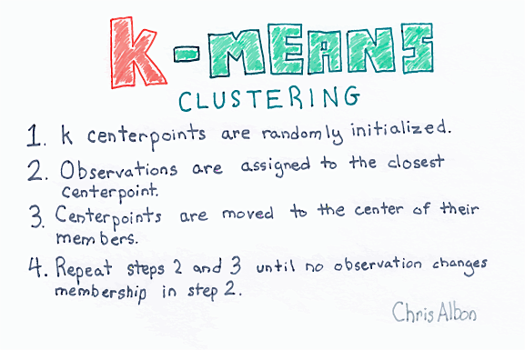

Slide 7
distance, centroids
Distance between points (X₀,Y₀,Z₀) and (X₁,Y₁,Z₁) is just sqrt((X₀- X₁)² + (Y₀- Y₁)² + (Z₀- Z₁)²)
In numpy
>>> import numpy as np
>>> p1 = np.array([0,-2,0,1]) ; p2 = np.array([0,1,2,1]))
>>> np.linalg.norm(p1 - p2)
3.605551275463989
Computing centroid of set of points easy
>>> points = np.array([[1,2,3], [2,1,1], [3,1,0]]) # 3D points
>>> centroid = np.mean(points, axis=0) # get mean across columns
>>> centroid
array([2.0, 1.33, 1.33])

Slide 8
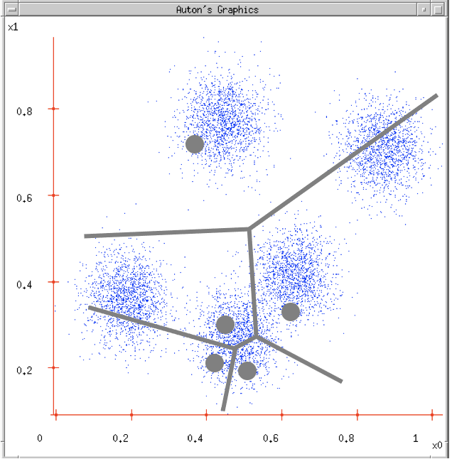
K-Means Clustering
K-Means ( k , data )
Randomly choose k cluster center locations (centroids)
Loop until convergence
Assign each point to the cluster of the closest centroid.
Re-estimate the cluster centroids based on the data assigned to each
Convergence: no point is assigned to a different cluster
veroni diagram: add lines for regions of points closest to each centroid

Slide 9
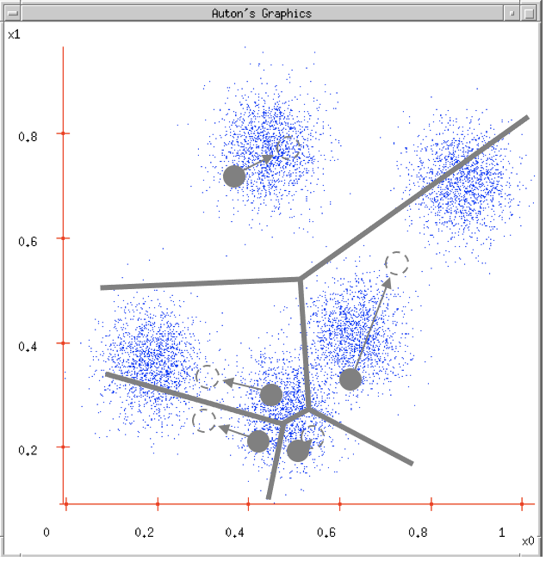
K-Means Clustering
K-Means ( k , data )
Randomly choose k cluster center locations (centroids)
Loop until convergence
Assign each point to the cluster of the closest centroid
Re-estimate the cluster centroids based on the data assigned to each
Convergence: no point is assigned to a different cluster

Slide 10
K-Means Clustering
K-Means ( k , data )
Randomly choose k cluster center locations (centroids)
Loop until convergence
Assign each point to the cluster of the closest centroid
Re-estimate the cluster centroids based on the data assigned to each
Convergence: no point is assigned to a different cluster

Slide 11
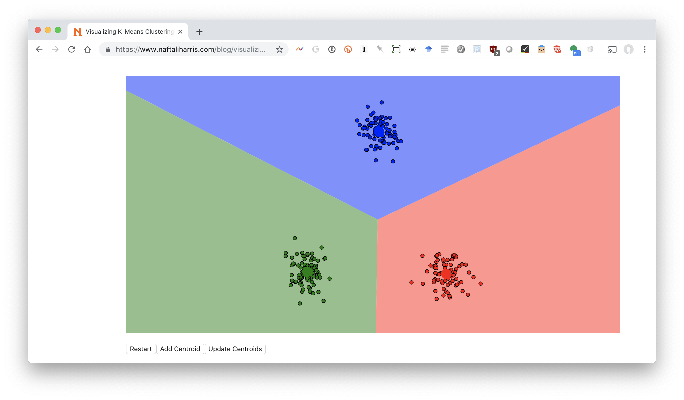
Visualizing k-means: http://bit.ly/471kmean

Slide 12
Problems with K-Means
Only works for numeric data (typically reals)
Very sensitive to the initial points
fix: Do many runs, each with different initial centroids
fix: Seed centroids with non-random method, e.g., farthest-first sampling
Sensitive to outliers
E.g.: find three
fix: identify and remove outliers
Must manually choose k
Learn optimal k using some performance measure

Slide 13
(2) Hierarchical clustering
Agglomerative
Bottom-up approach: elements start as individual clusters & clusters are merged as one moves up the hierarchy
Divisive
Top-down approach: elements start as a single cluster & clusters are split as one moves down the hierarchy

Slide 14
Hierarchical clustering advantages
Need not specify number of clusters
Good for data visualization
See how data points interact at many levels
Can view data at multiple granularity levels
Understand how all points interact
Specifies all of the K clusterings/partitions

Slide 15
Divisive hierarchical clustering
Top-down technique to find best partitioning of data, generally exponential in time
Common approach:
Let C be a set of clusters
Initialize C to be a one-clustering of data
While there exists a cluster c in C
remove c from C
partition c into 2 clusters (c₁ and c₂ ) using a flat clustering algorithm (e.g., k-means)
Add to c₁ and c₂ C
Bisecting k-means

Slide 16
Divisive clustering

Slide 17
Divisive clustering
start with one cluster

Slide 18
Divisive clustering
use flat clustering to split into two clusters (e.g., using K-means with k=2)

Slide 19
Divisive clustering

Slide 20
Divisive clustering
split using flat clustering, e.g., Kmeans

Slide 21
Divisive clustering
split using flat clustering
split using flat clustering, e.g., Kmeans

Slide 22
Divisive clustering
Stop when clusters reach some constraint

Slide 23
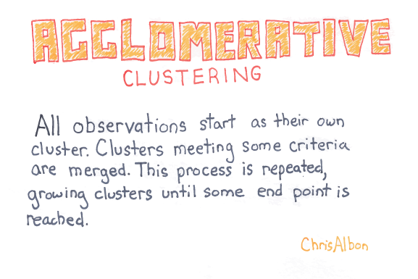

Slide 24
Hierarchical Agglomerative Clustering
Let C be a set of clusters
Initialize C to all points/docs as separate clusters
While C contains more than one cluster
find c₁ and c₂ in C that are closest together
remove c₁ and c₂ from C
merge c₁ and c₂ and add resulting cluster to C
Merging history forms a binary tree or hierarchy
Q: How to measure distance between clusters?

Slide 25
Distance between clusters
Single-link: Similarity of the most similar (single-link)
Weka: linkType=SINGLE

Slide 26
Distance between clusters
Complete-link: Similarity of the “furthest” points, the least similar
Weka: linkType=COMPLETE

Slide 27
Distance between clusters
Centroid: Clusters whose centroids (centers of gravity) are the most similar
Weka: linkType=CENTROID

Slide 28
Distance between clusters
Average-link: Average similarity between all pairs of elements
Weka: linkType=AVERAGE

Slide 29
Knowing when to stop
General issue is knowing when to stop merging/splitting a cluster
We may have a problem specific desired range of clusters (e.g., 3-6)
There are some general metrics for assessing quality of a cluster
There are also domain specific heuristics for cluster quality

Slide 30
(3) DBSCAN Algorithm
Density-Based Spatial Clustering of Applications with Noise
Clusters close points based on a distance and a minimum number of points
Key parameters: eps=maximum distance between two points; minPoints= minimal cluster size
Marks as outliers points in low-density regions
Needn’t specify number of clusters expected
Fast

Slide 31
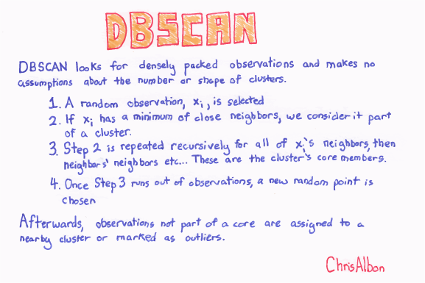

Slide 32

DBSCAN Example
This gif (in ppt) shows how DBSCAN grows four clusters and identifies the remaining points as outliers

